Slide 1

Let’s React
Urban Cvek
@urbancvek
git clone https://github.com/urbancvek/react-workshop.git

Slide 2
ES@next
Vedno bolj zahtevne spletne aplikacije
Podpiranje starih brskalnikov
Nove funkcionalnosti (“syntactic sugar”)

Slide 3
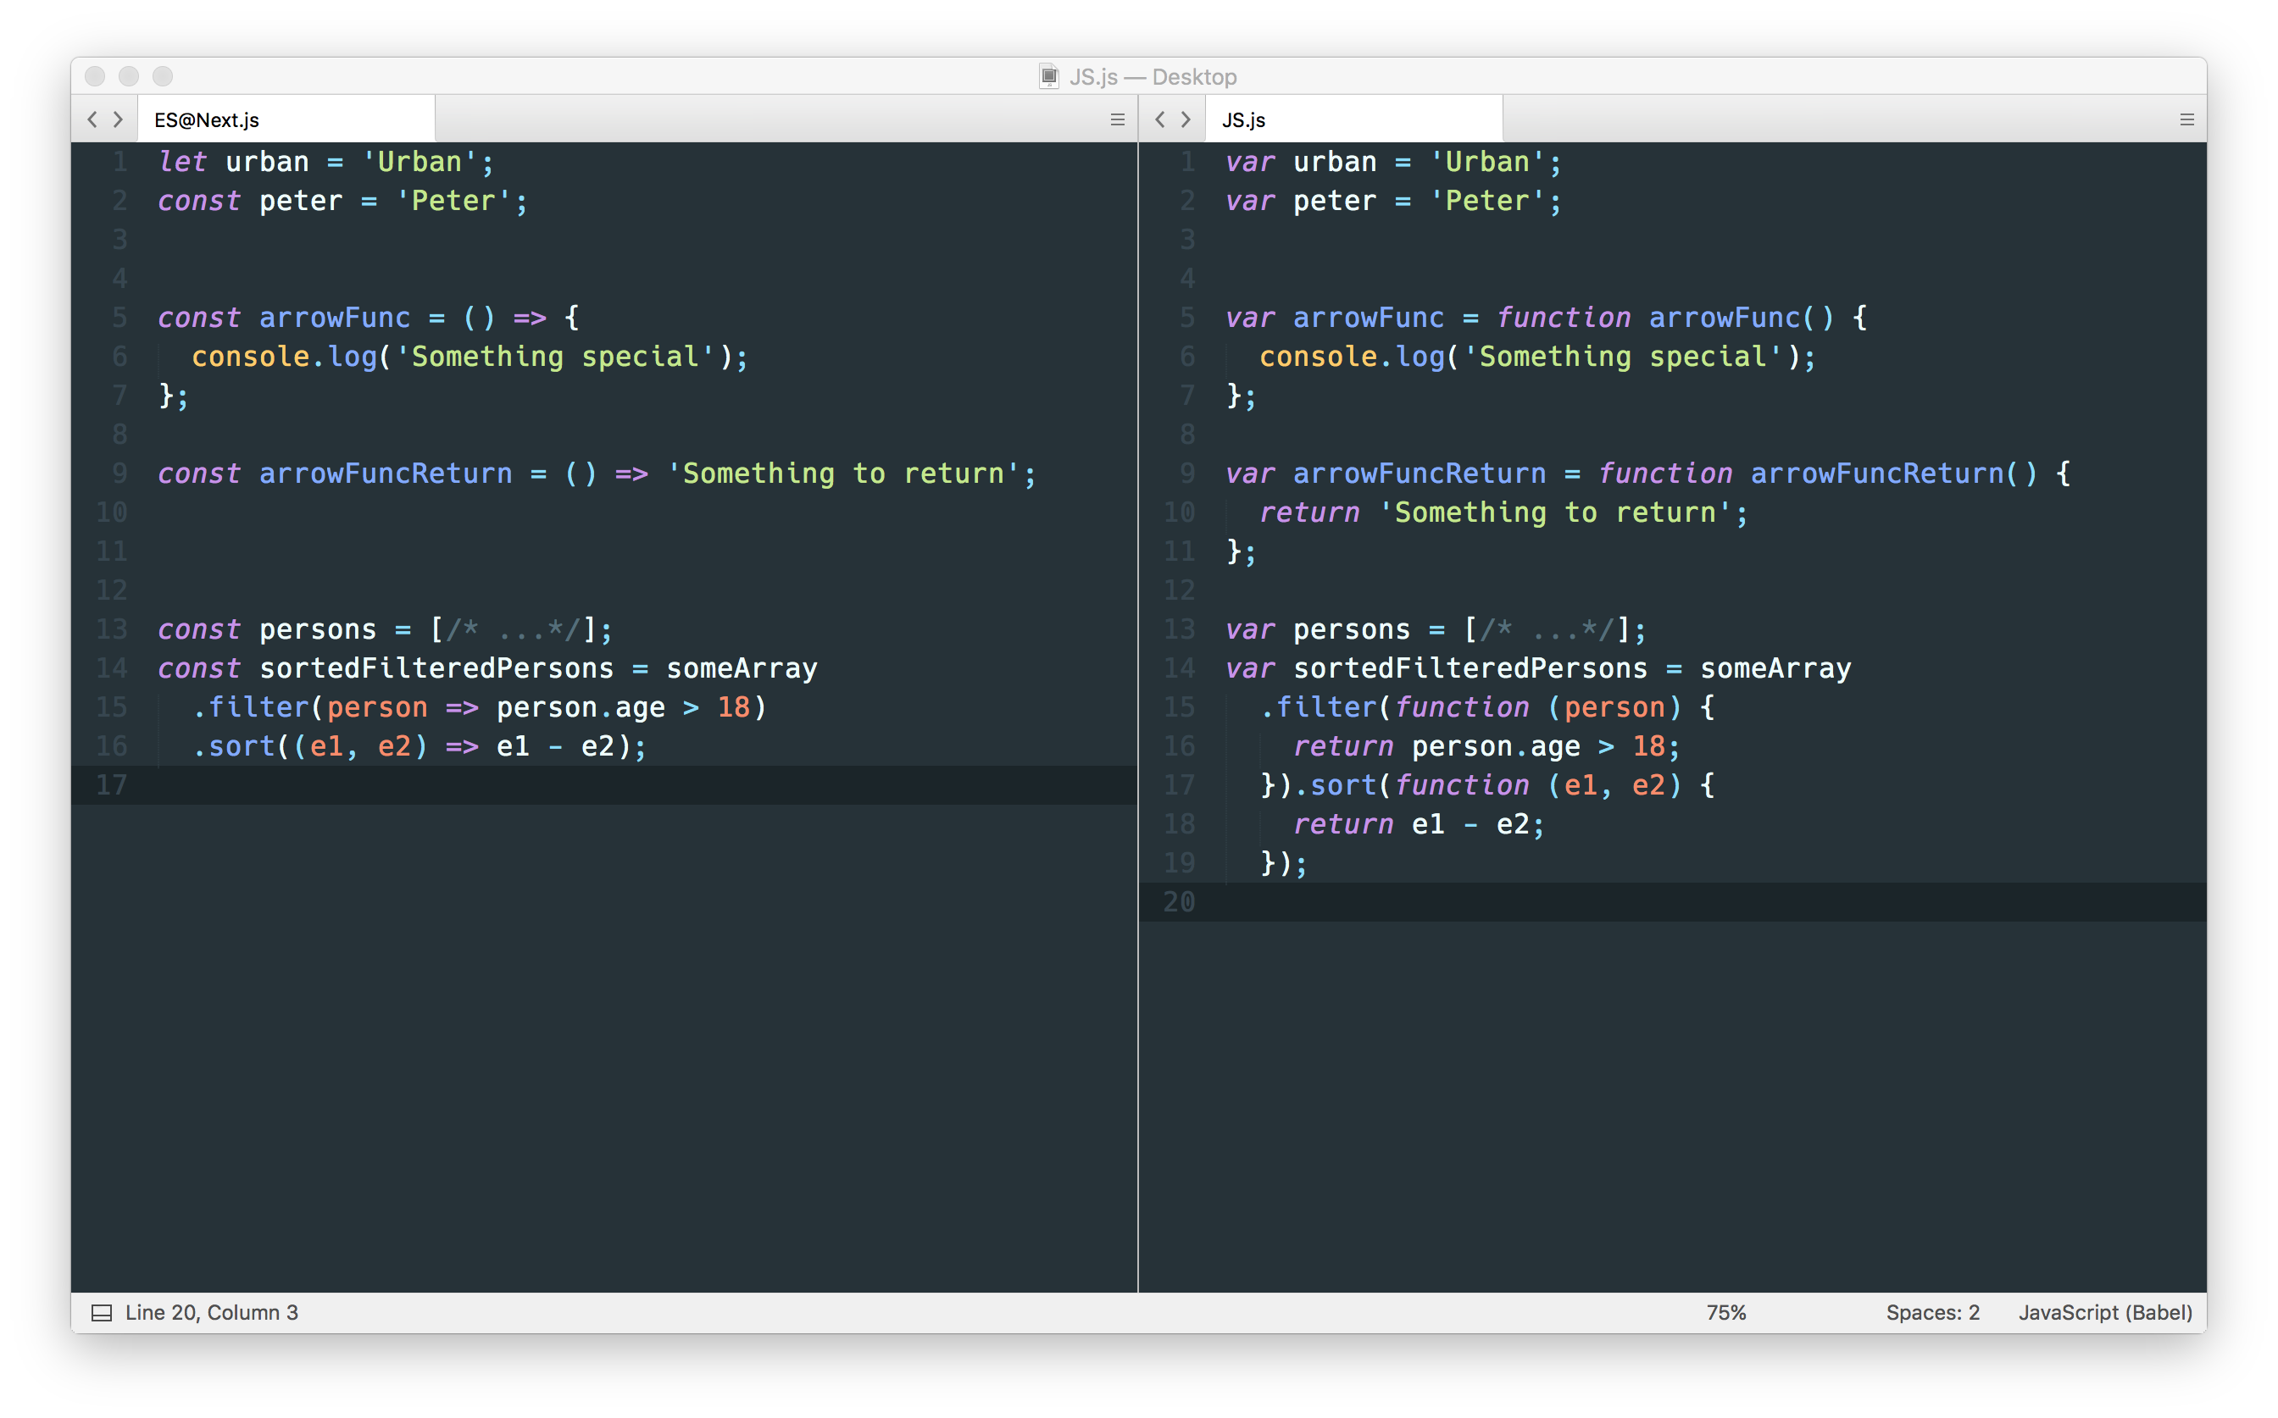
ES@next
variable declaration
arrow functions

Slide 4
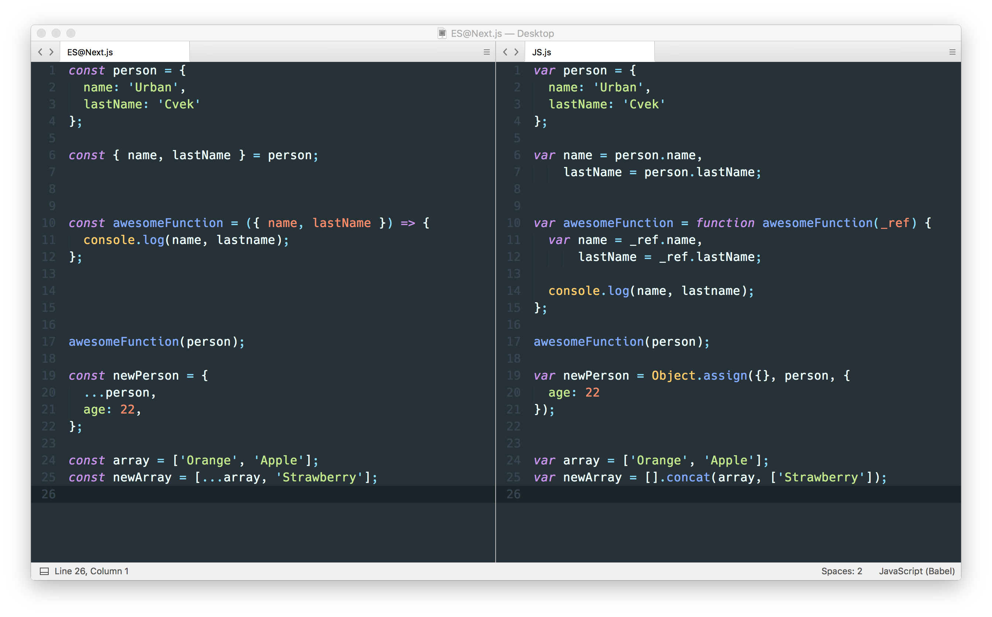
ES@next
object destructuring
destructuring assignment

Slide 5
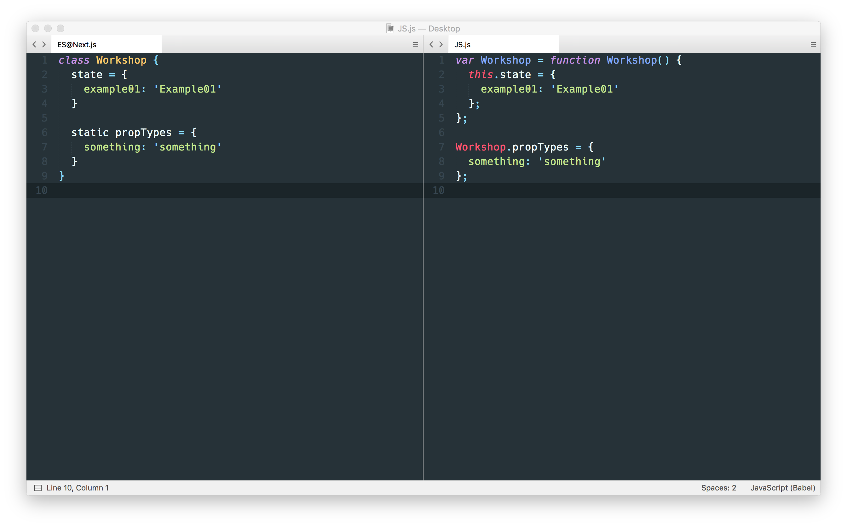
ES@next
classes

Slide 6
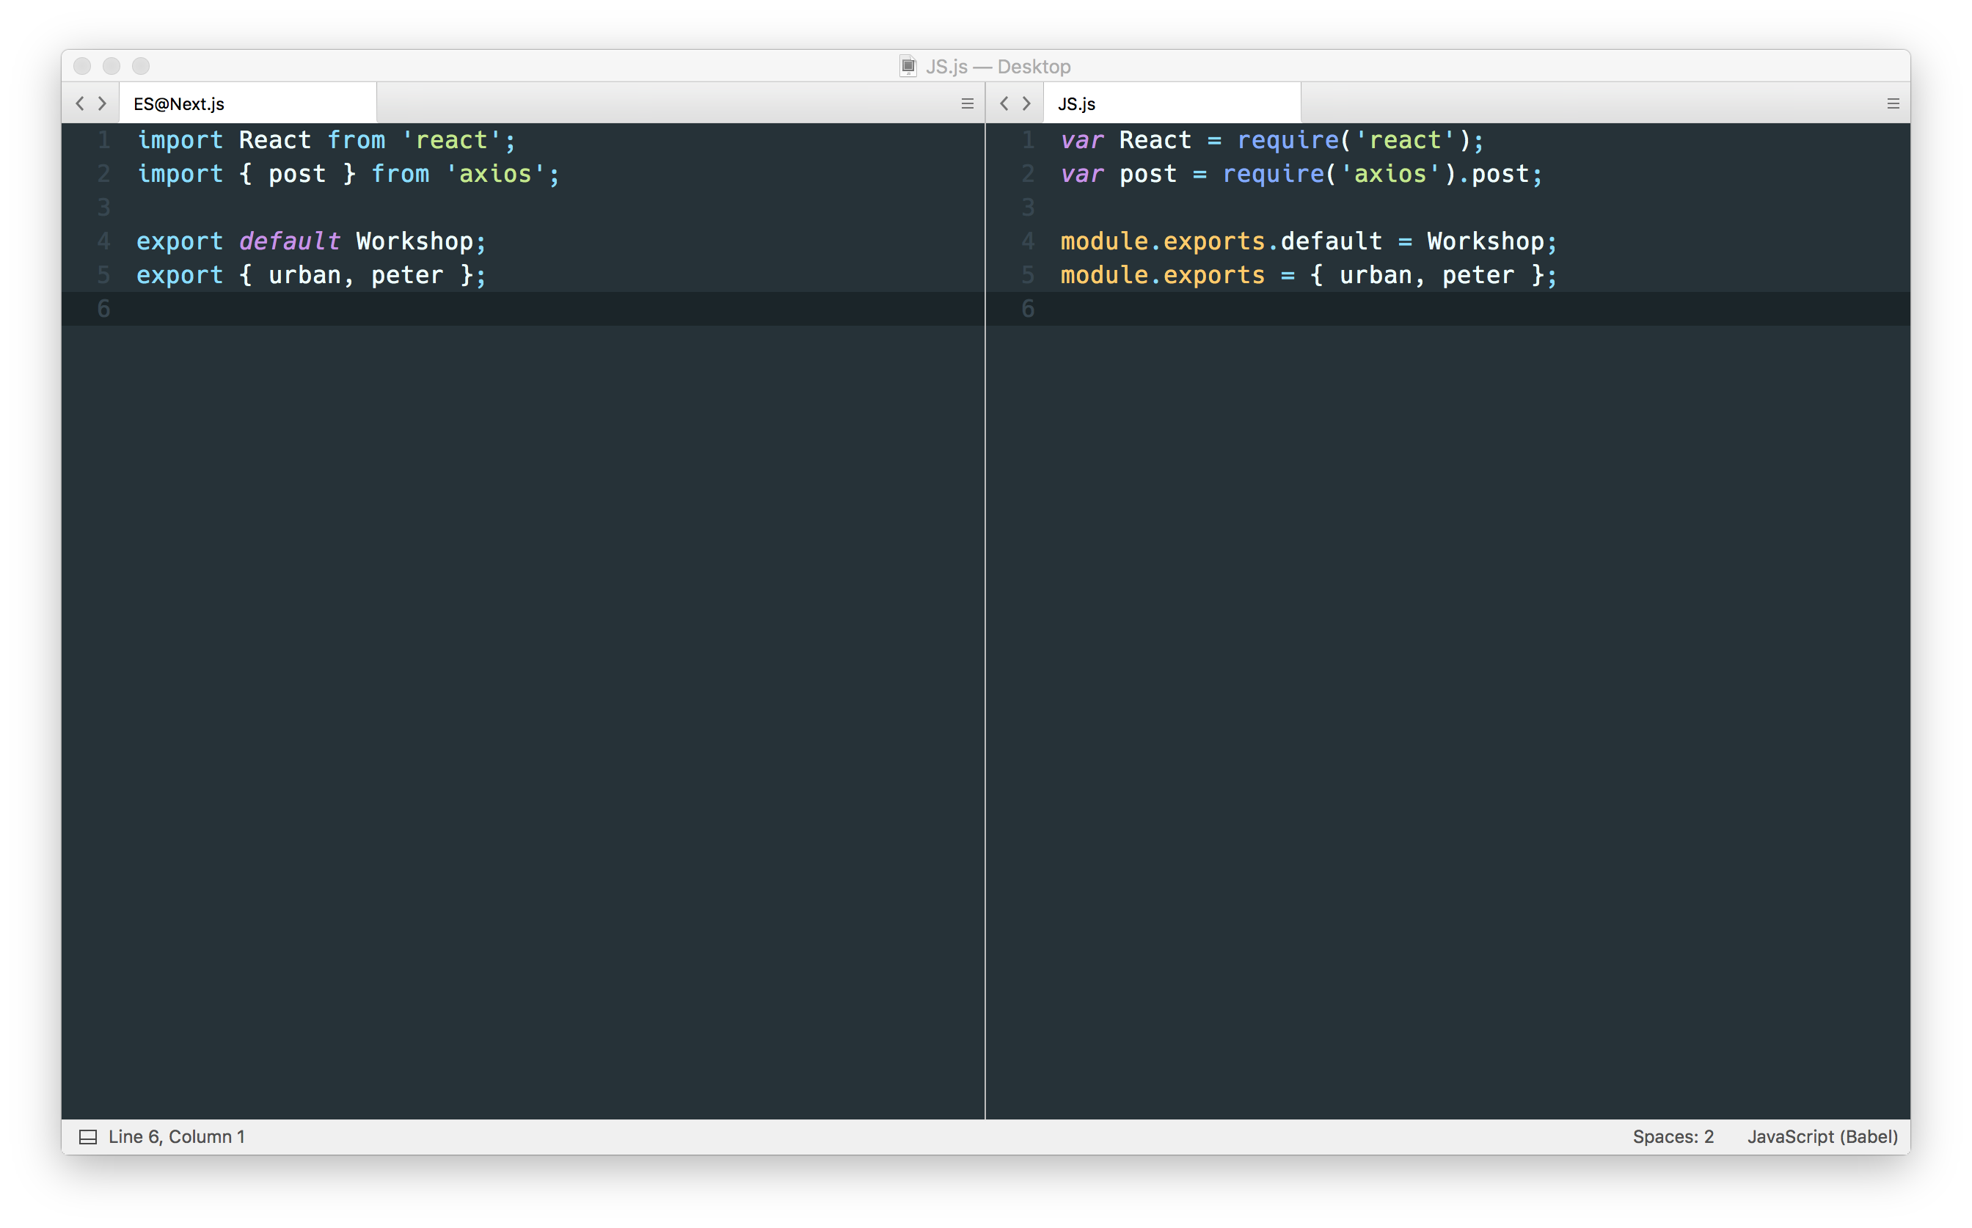
ES@next
modules

Slide 7
JSX
XML v Javascript
Vedno en “root” element

Slide 8
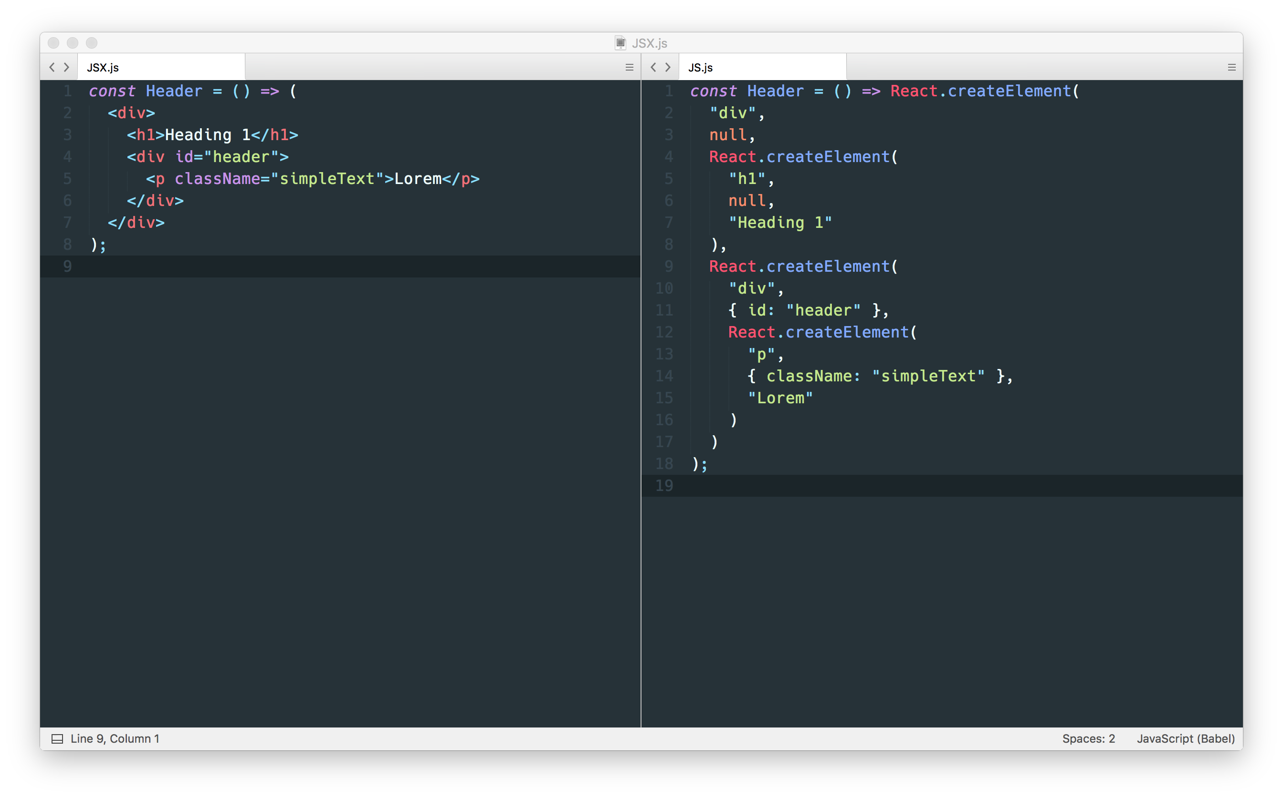
JSX

Slide 9
React
“View” v “MVC” modelu
Ne potrebuje DOM-a (deluje na serverju)
Virtual DOM
čim manj interakcij z DOM-om
elementi predstavljeni kot objekti

Slide 10
Hello World Example
<HelloProps />
<HelloChildren />
props
props
firstName: string
lastName: string
children: ?any

Slide 11
Click Counter Example
<ClickCounter />
state
timesClicked: number

Slide 12
Stopwatch Example
<Stopwatch />
state
time: number
timing: boolean

Slide 13
Form Example
<Form />
state
firstName: string
email: string
age: string

Slide 14
API Example
types
PokemonType: {
name: string
image: string
weight: number
xp: number
}
<PokeList />
props
state
pokemons: Array<string>
pokemons: Array<PokemonType>
<PokeDisplay />
<PokeDisplay />
<PokeDisplay />
props
props
props
pokemon: PokemonType
pokemon: PokemonType
pokemon: PokemonType

Slide 15
React Router Example
<Navbar />
<Route />
<Route />
props
props
exact?: boolean
path: string
component: ReactComponent
path: string
component: ReactComponent

Slide 16
React Router Example
<Navbar />
<Route />
<Route />
props
props
exact?: boolean
path: string
component: ReactComponent
path: string
component: ReactComponent

